Slide 1
Radioactive Activation of SciFi
Omar Sayeed Saimum [Saimum]
omars.saimum@kaist.ac.kr/cern.ch
3rd year undergraduate student
Dept. of Physics, KAIST, Daejeon, South Korea
Intern, Luminosity group of LHCb, LLR, Ecole Polytechnique, France
19th October 2023

Slide 2
Info on the Data & the Filling Scheme
May Mu Scan -> Fill: 8782
Contains 1773 bbs, 601 bes and ebs, and 589 ees
Bunch trains; short ee, be, eb trains; both ee and be after bb
June Mu Scan -> Fill: 9007
Contains 16 bbs, 124 bes and ebs, and 3300 ees
No bunch trains; Long ee trains; only ee appears after bb.
Only 29 kHz lines of HLT1 are analyzed
SciFi was (probably) warm during the Mu Scans.

Slide 3
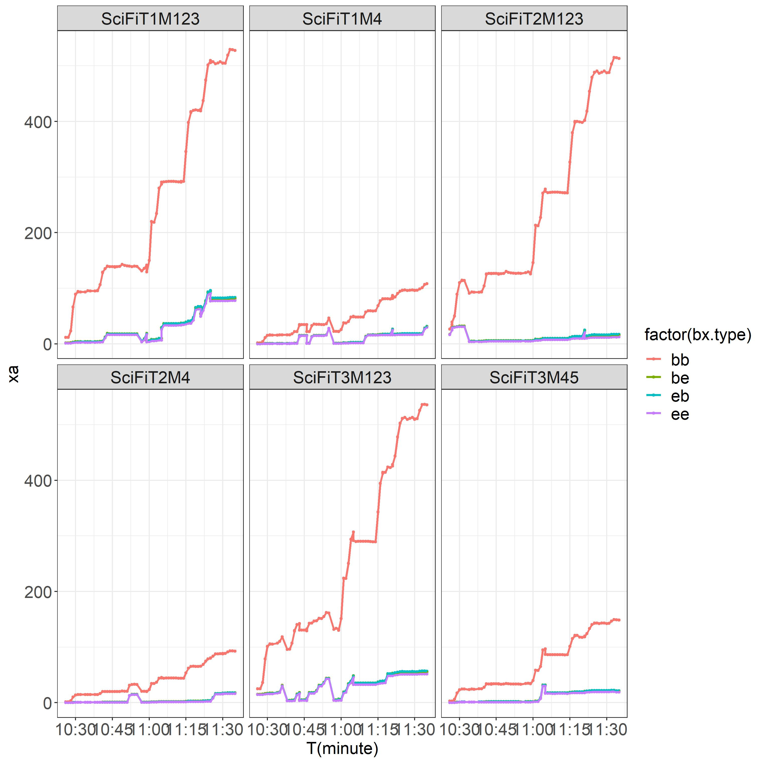
Average hits vs. Time for SciFis in May Mu Scan (fill: 8782)
X-axis: Time -> increasing mu
ee affected by the change in mu and it fluctuates.

Slide 4
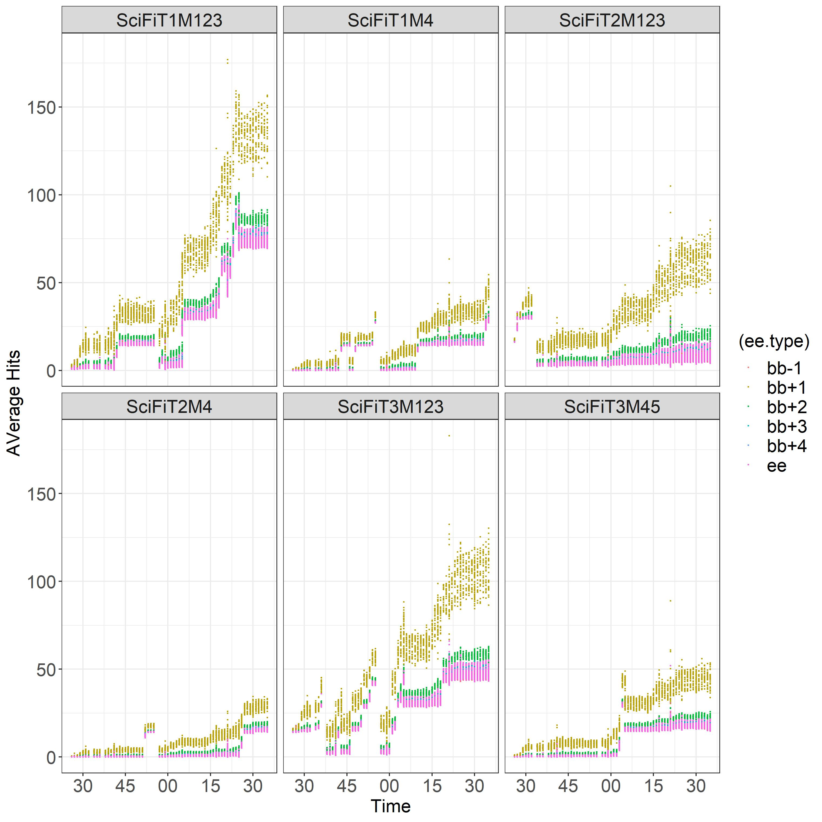
Average ee vs. Time for SciFis in ee in May Mu Scan (fill: 8782)
X-axis: Time -> increasing mu
Note: only ees & bb+(-)#: ees after (before) bbs
ee affected by the change in mu and it fluctuates.
Two plausible explanation: time misalignment and/or activation

Slide 5
Method
Characterize the ee bunch crossings based on their relative location to the bb bunch crossings.
If the discrepancy is caused by time misalignment -> bb+1 or so would be affected.
If activation -> exponential decay with further distancing from the bbs.

Slide 6
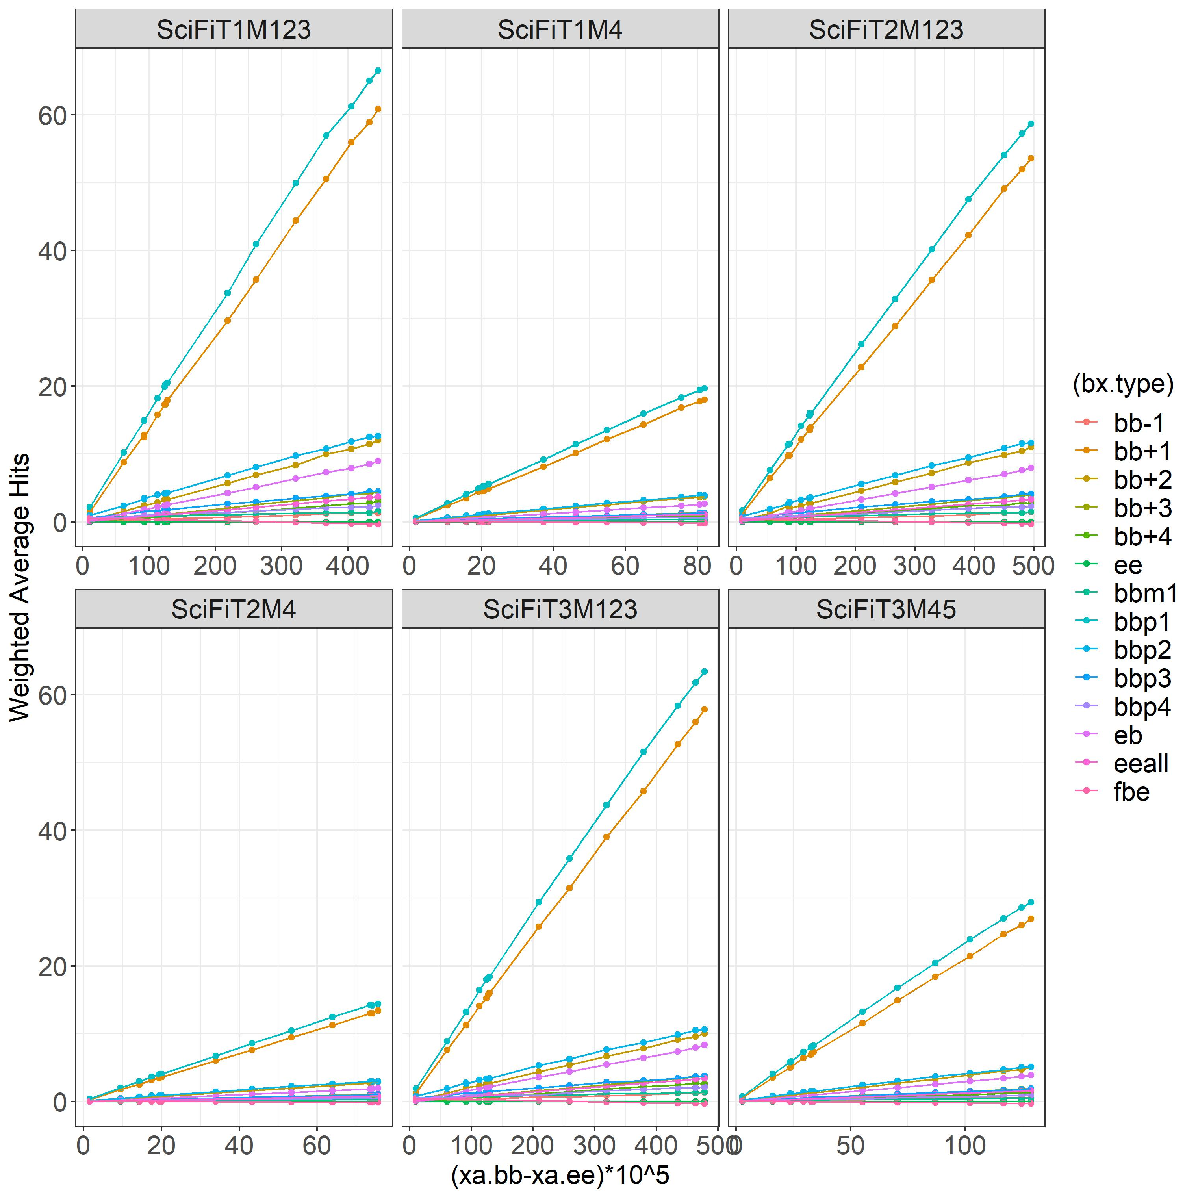
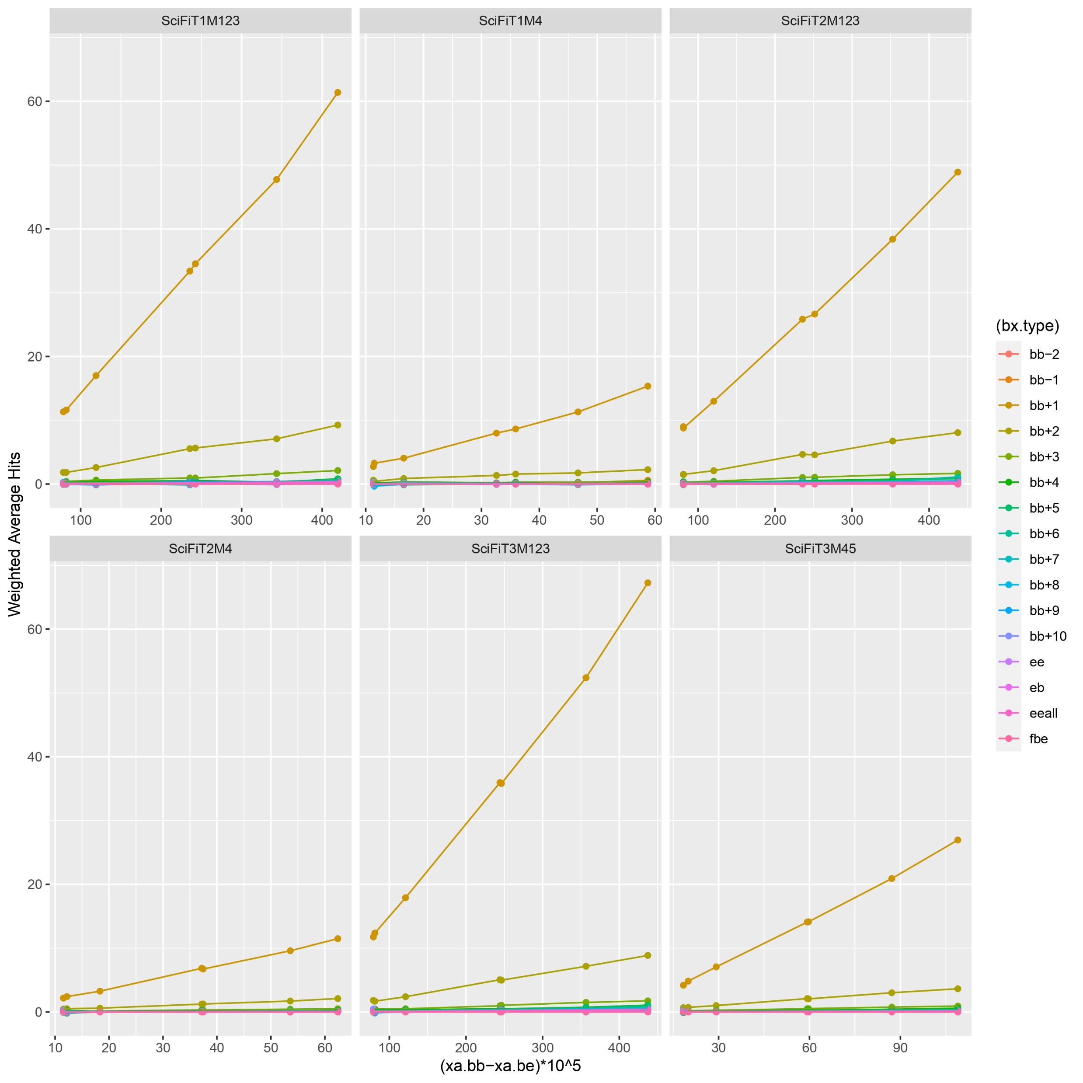
Average ee vs. background subtracted bb
NOTE:
bb’+/-’#: ee
bb’p/m’#:be
May (bb-ee)
June (bb-be)

Slide 7
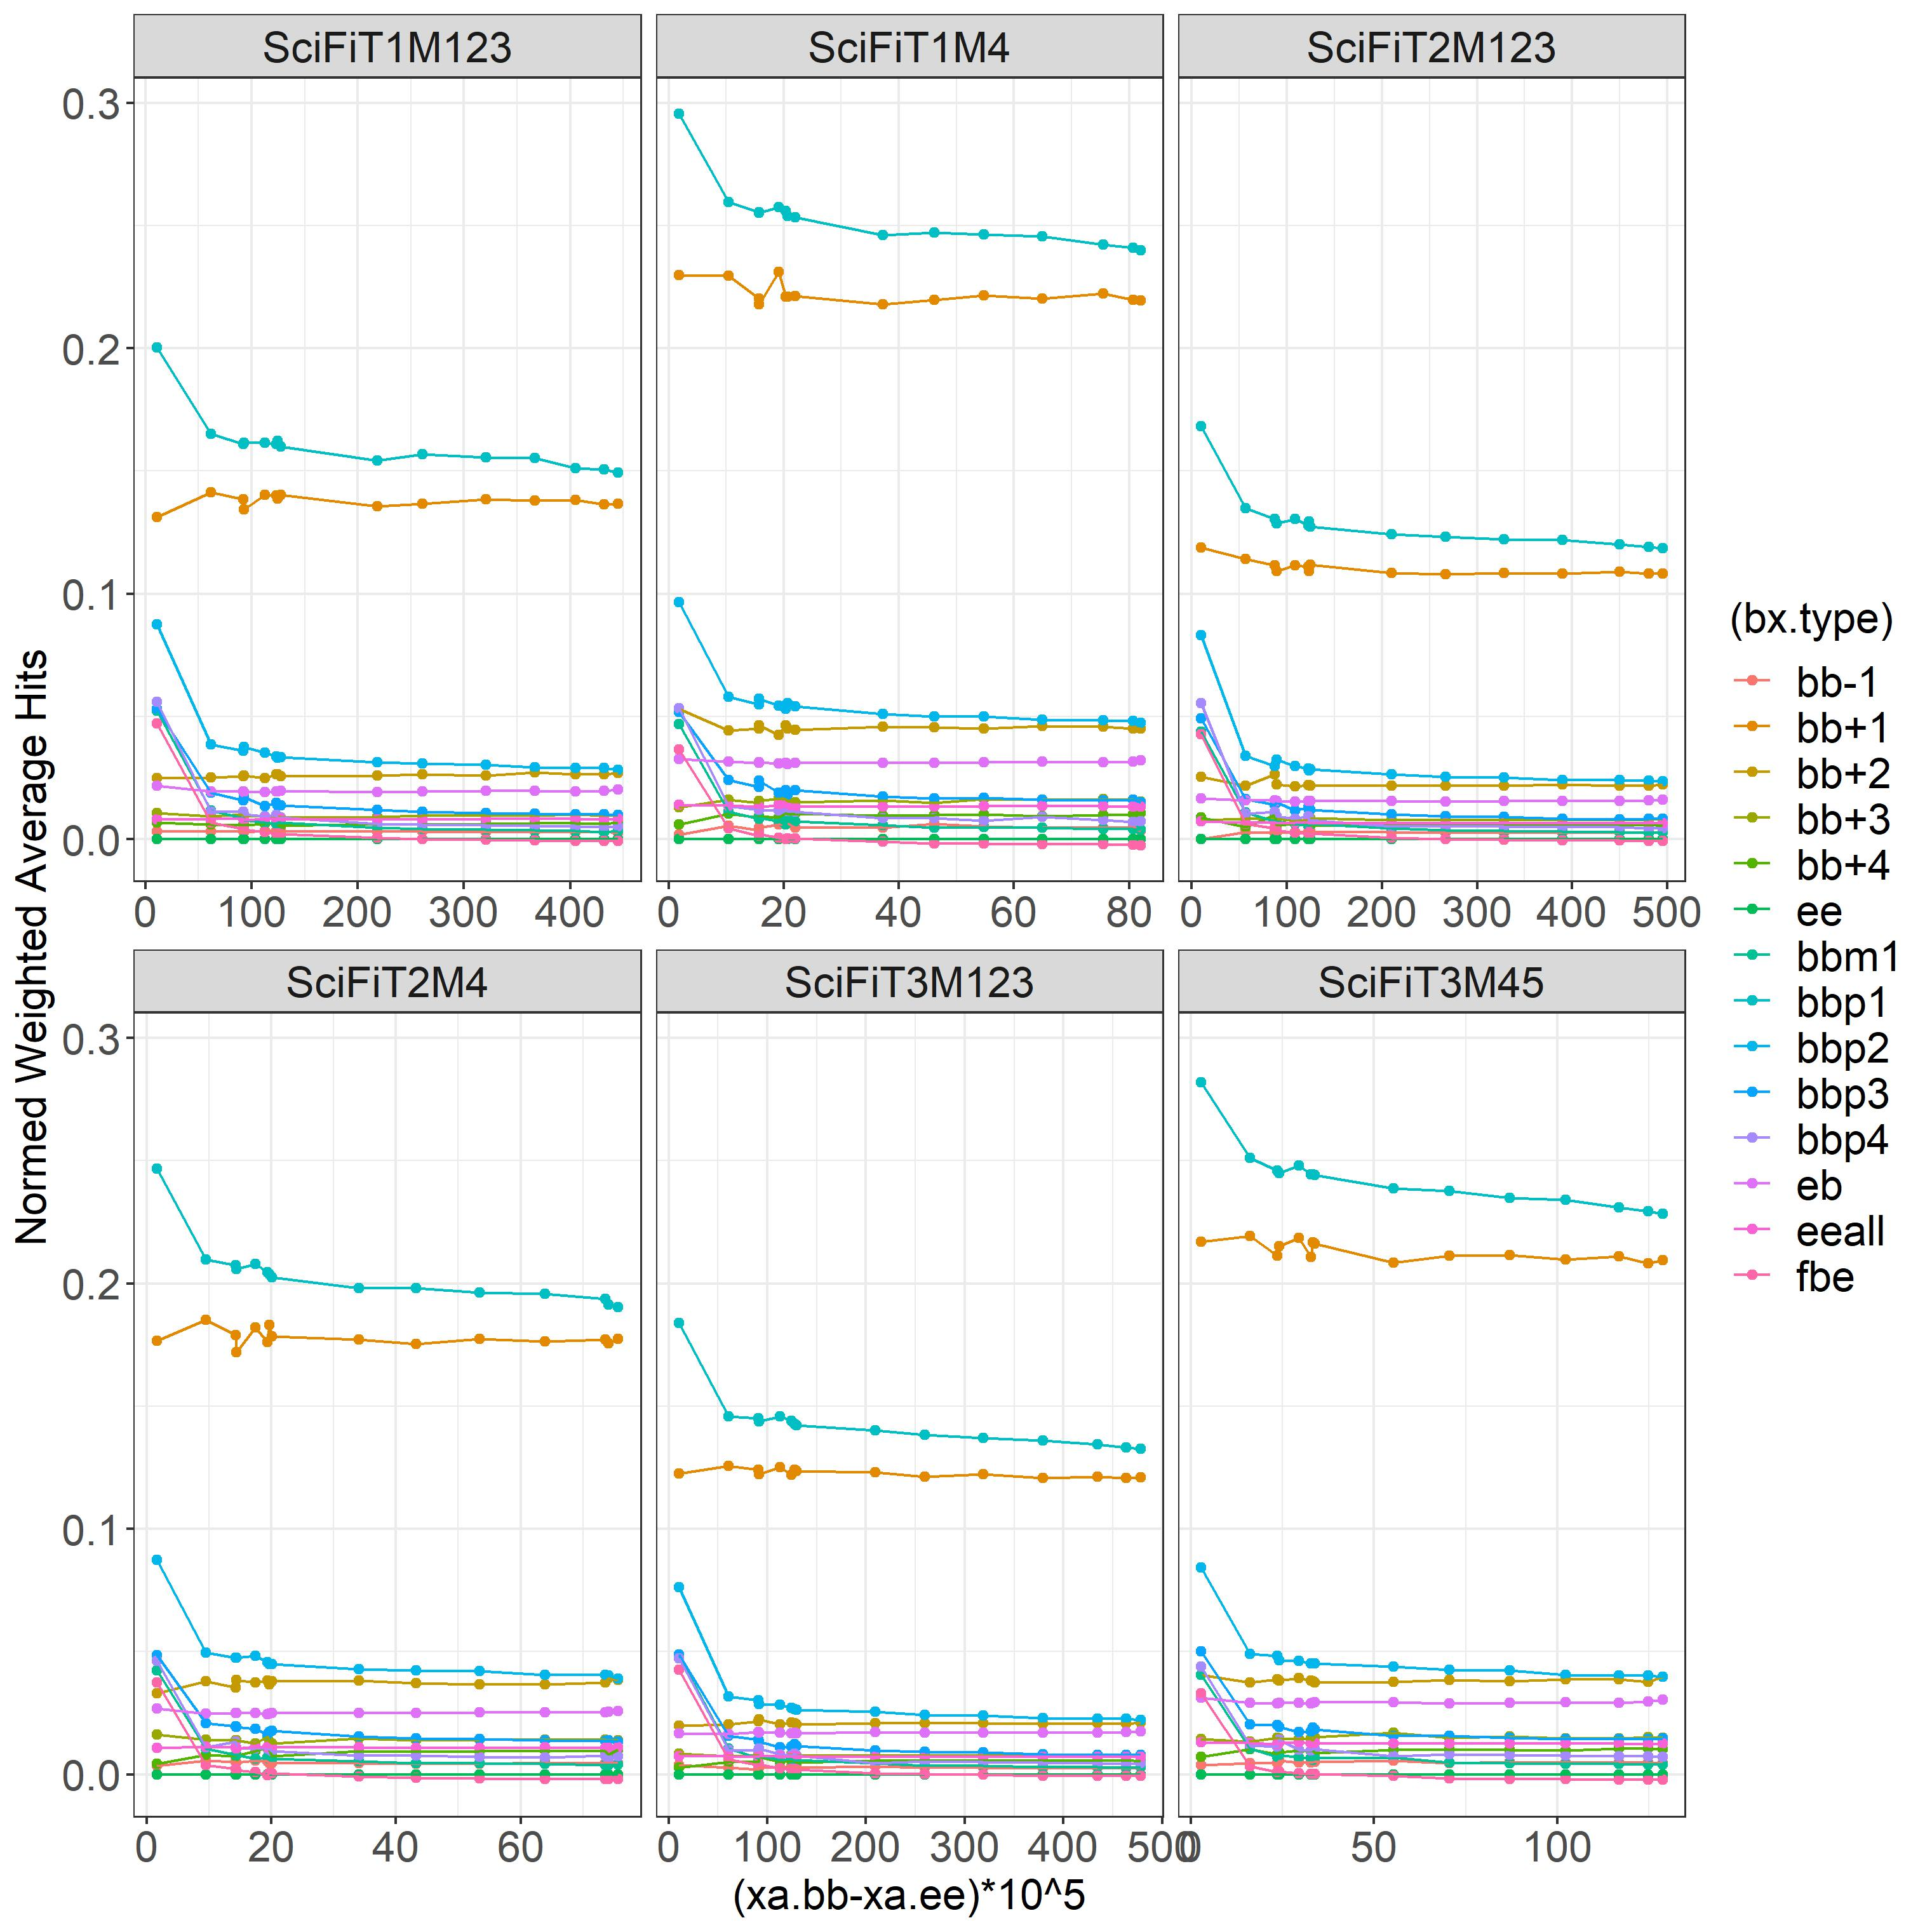
Avg ee vs. background subtracted bb
(Avg ee)/(bb-ee) vs. (bb-ee)
May Mu Scan
For each pair of lines, the upper ones are of be signals and the lower ones are ees -> beam-gas effect

Slide 8
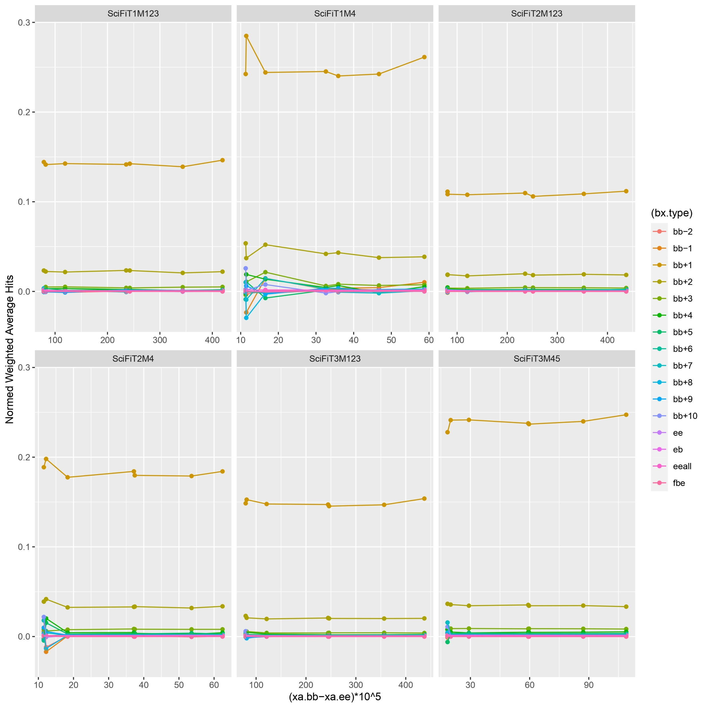

Avg ee vs. background subtracted bb
(Avg ee)/(bb-be) vs. (bb-be)
June Mu Scan
Note: for June mu scan, there were only ee bunch crossings after bb signals.

Slide 9
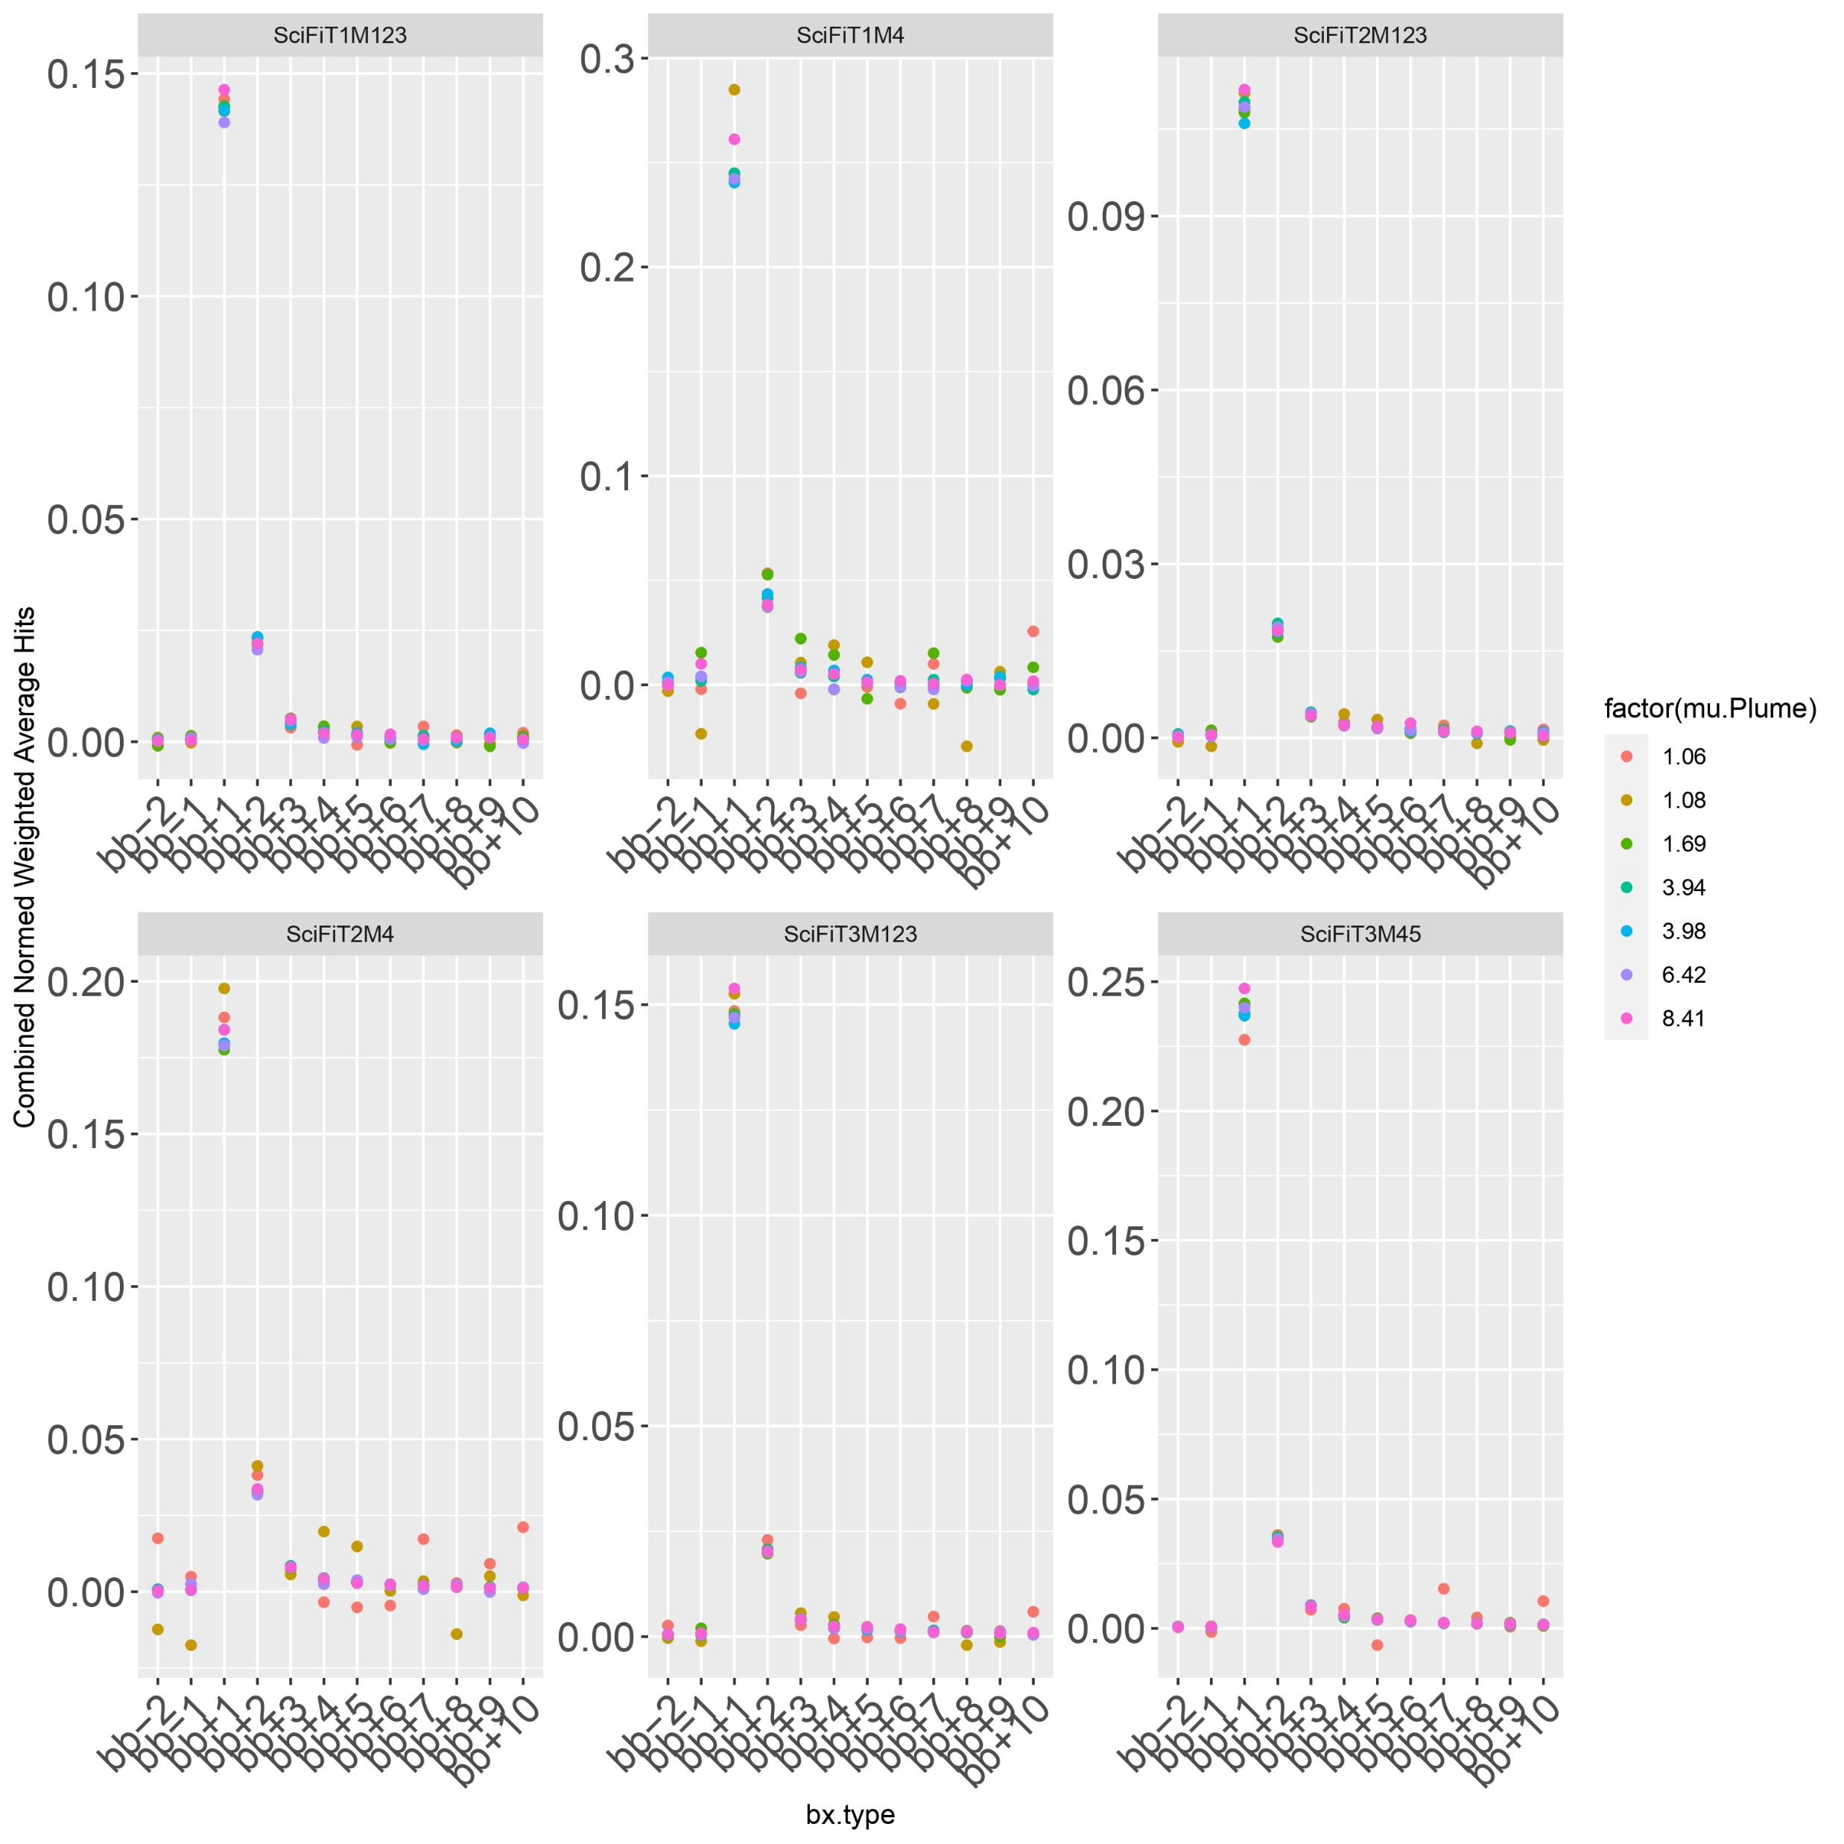
Avg. ee vs. position w.r.t. bb
Activation: up to ~25% for M4 and ~15% for M123 -> outers are more prone to activation.
bb+1: does not look like it fits properly as the rest -> probably have time misalignment effects in addition to activation.
Lower mu: background subtraction needs to be more rigorous.

Slide 10
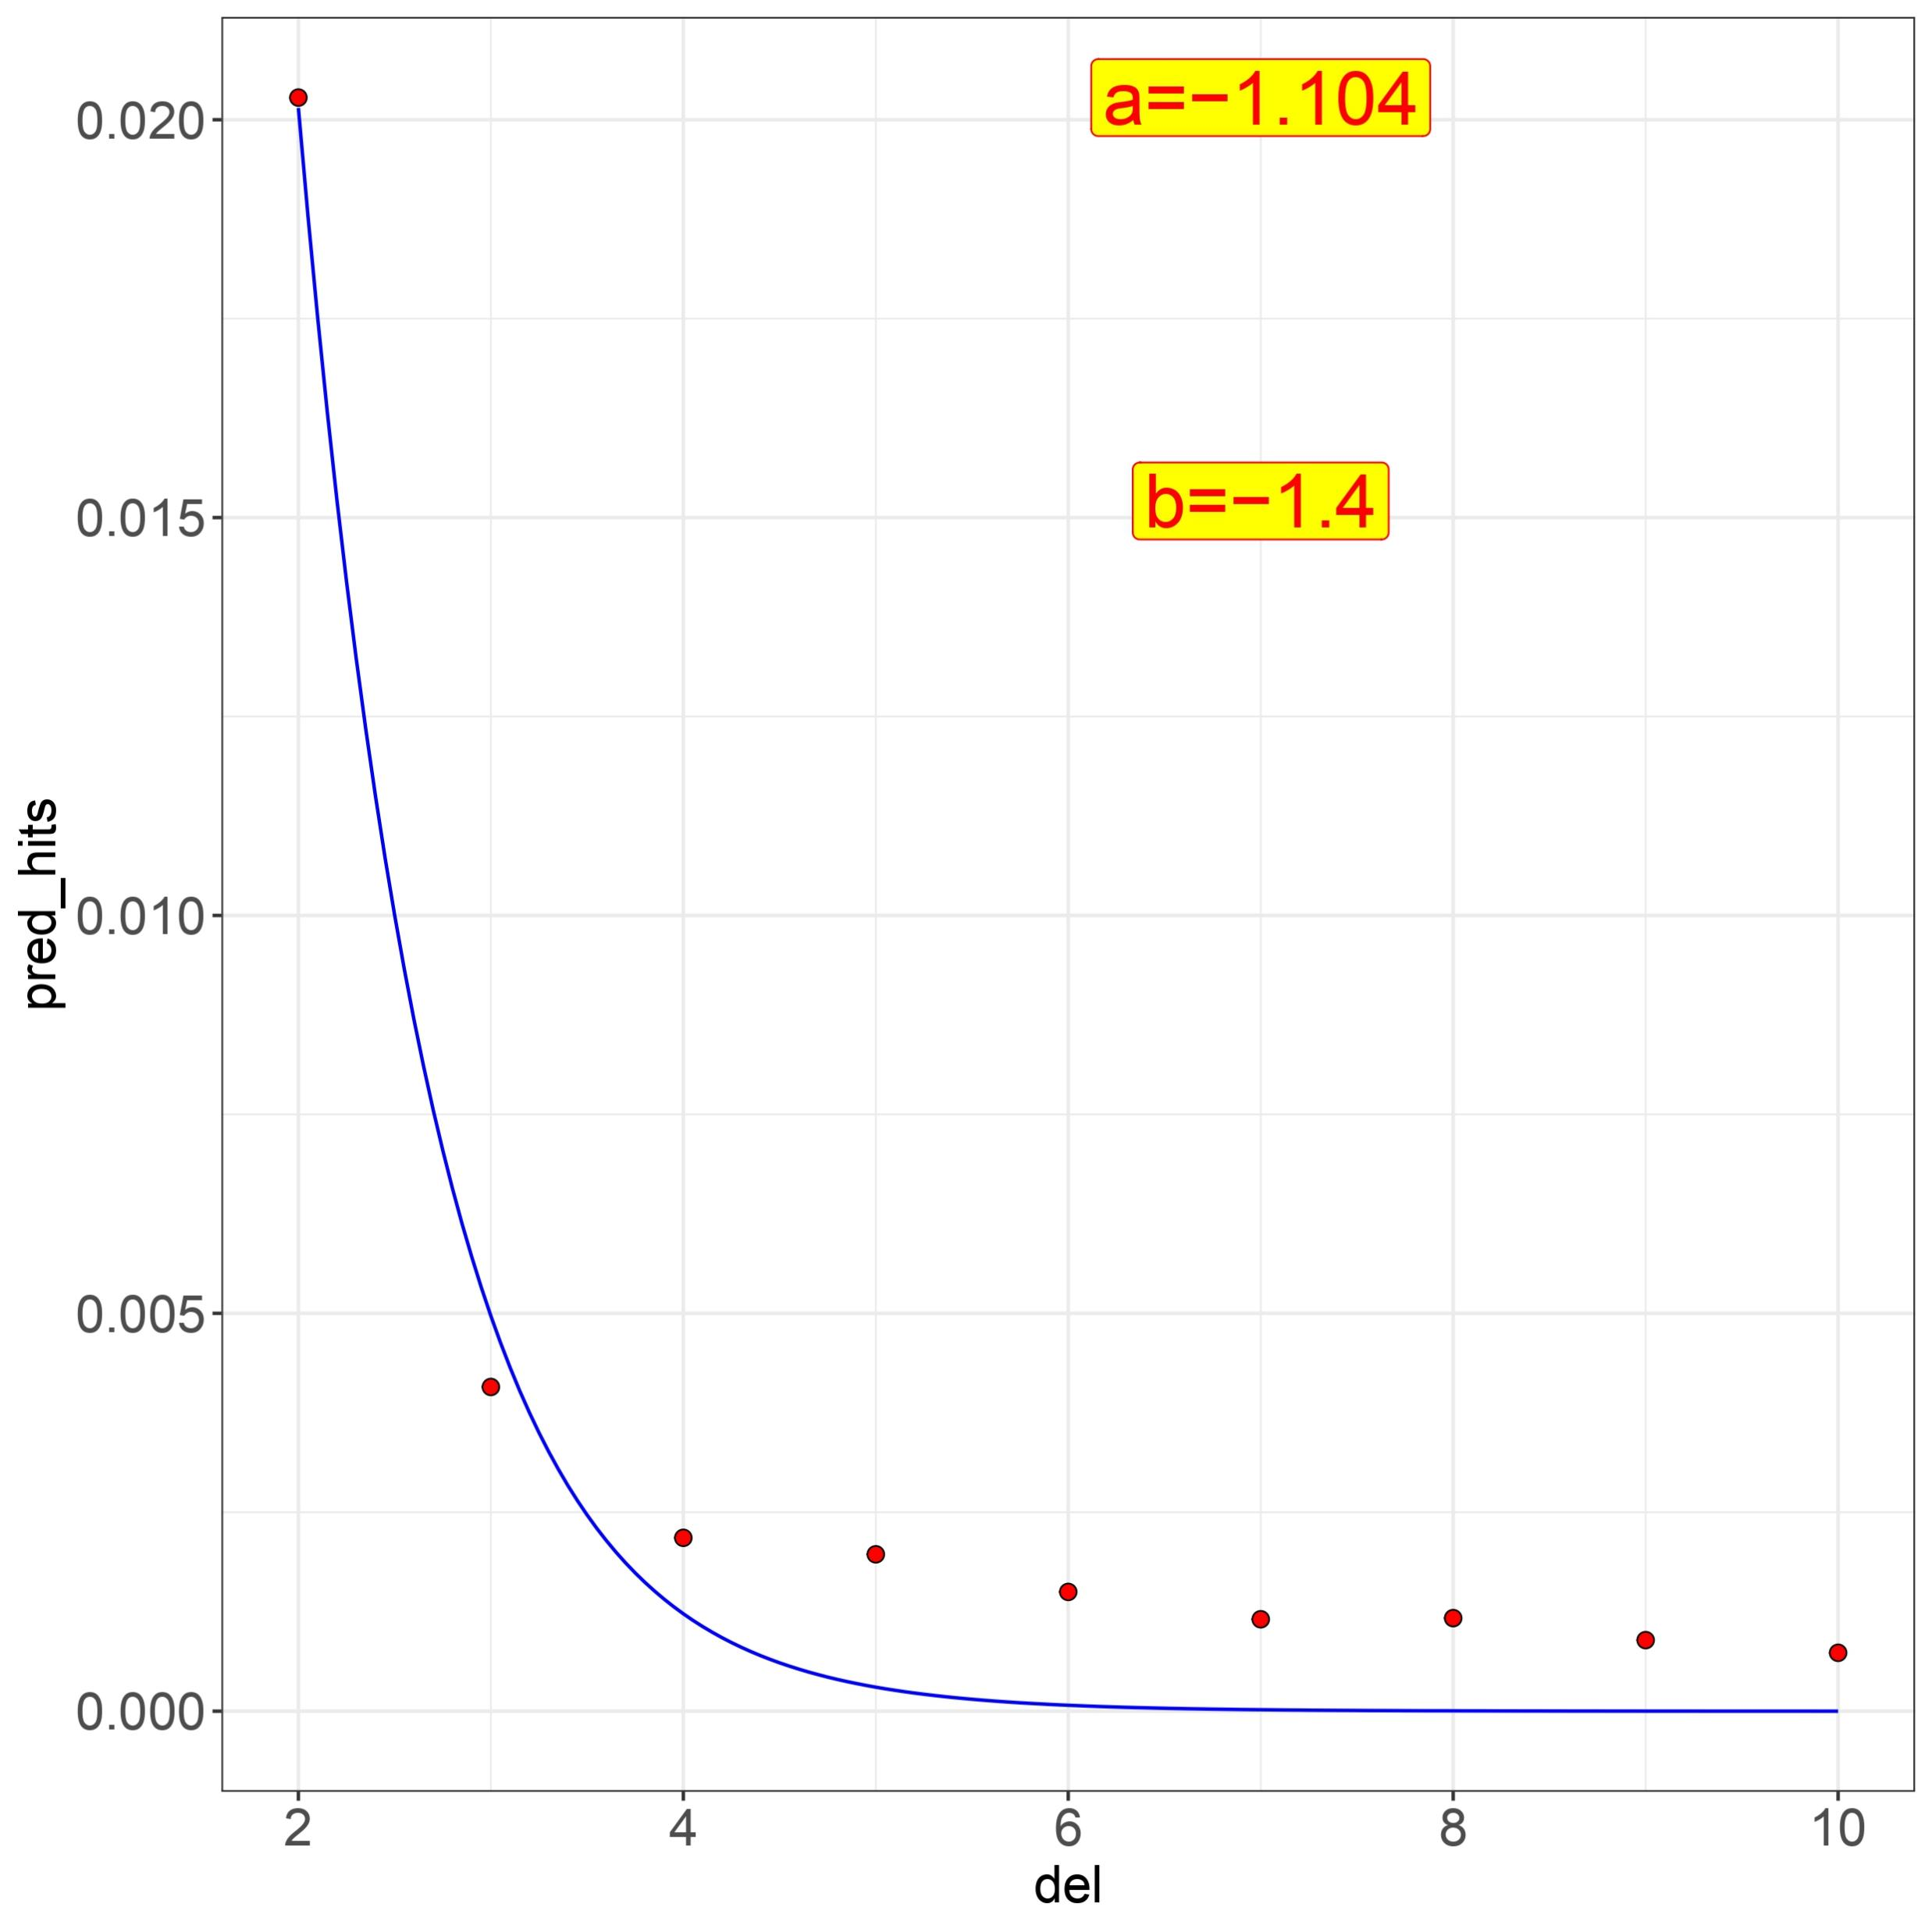
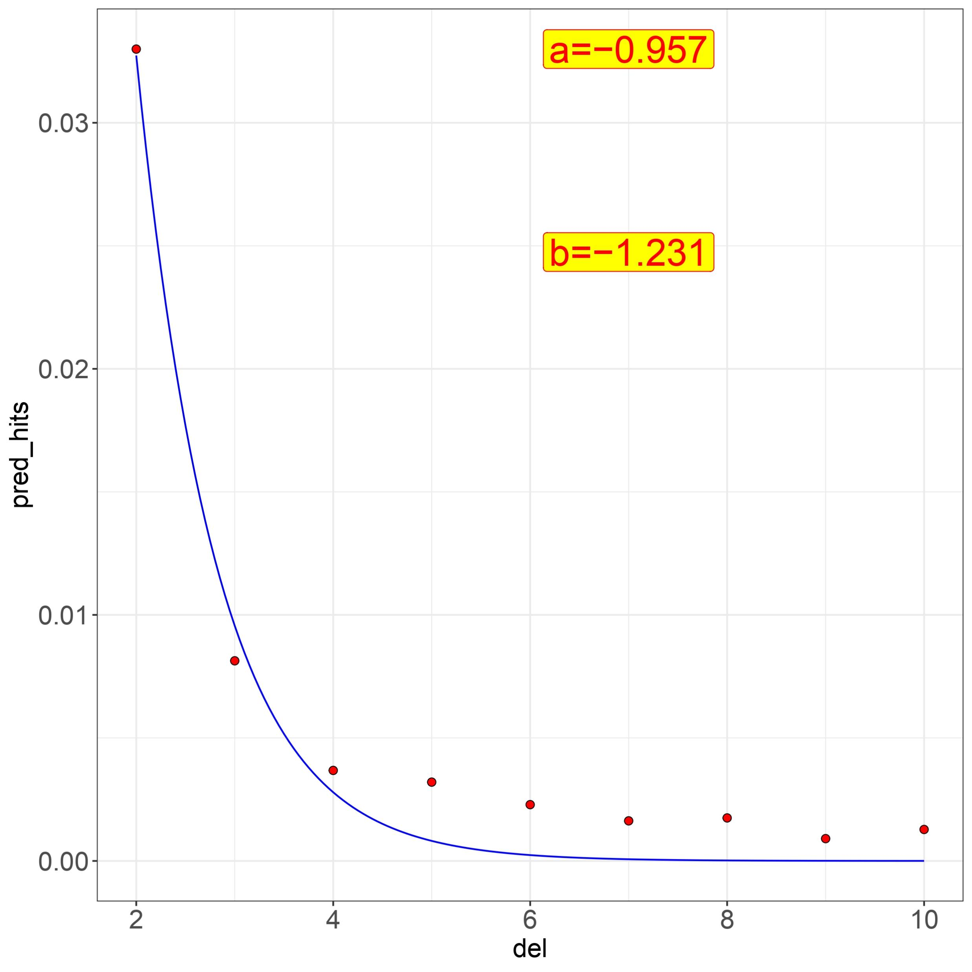
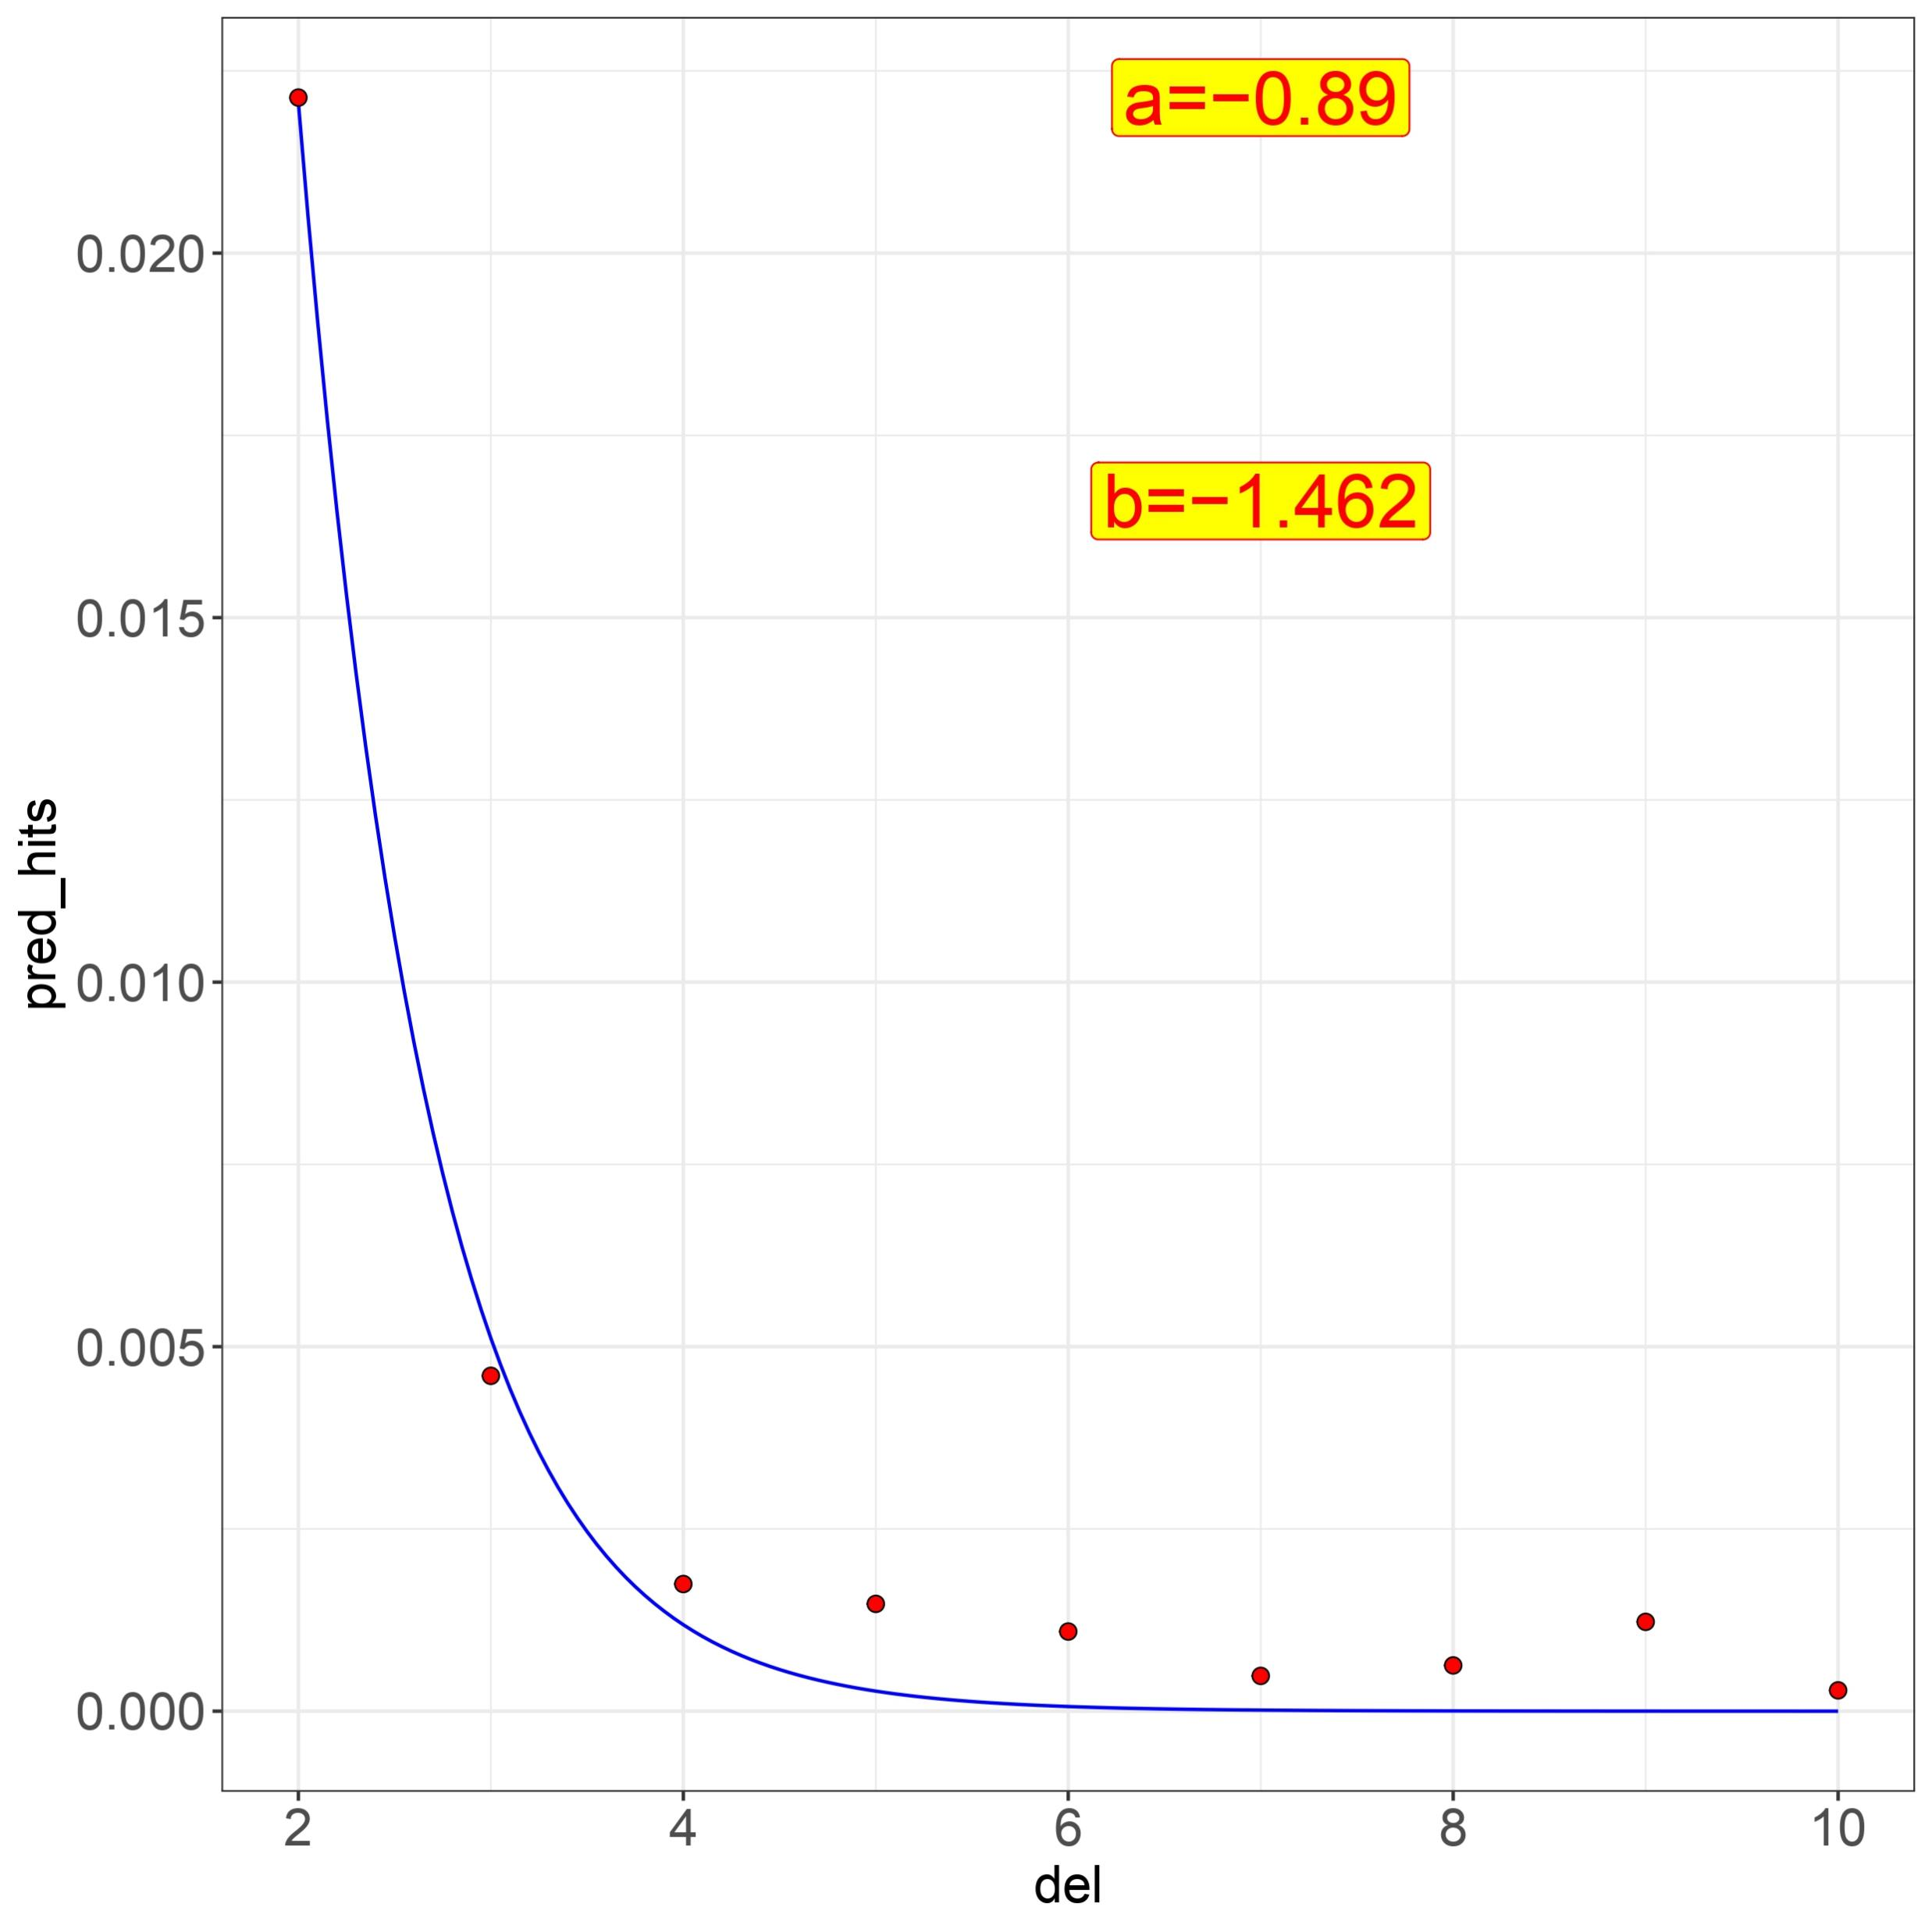
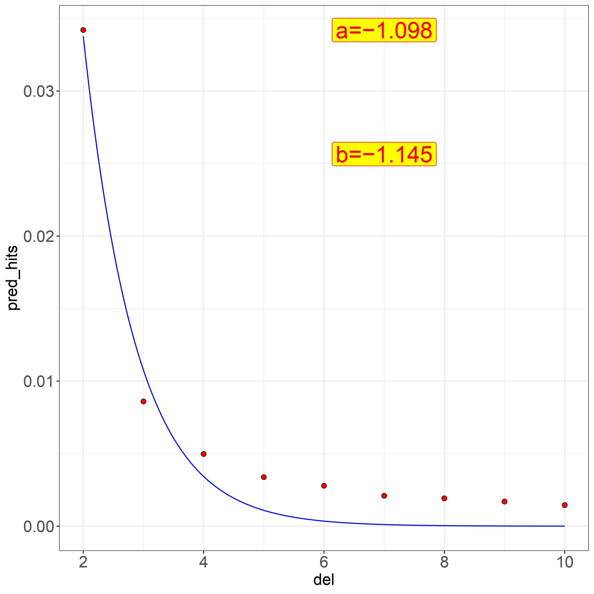
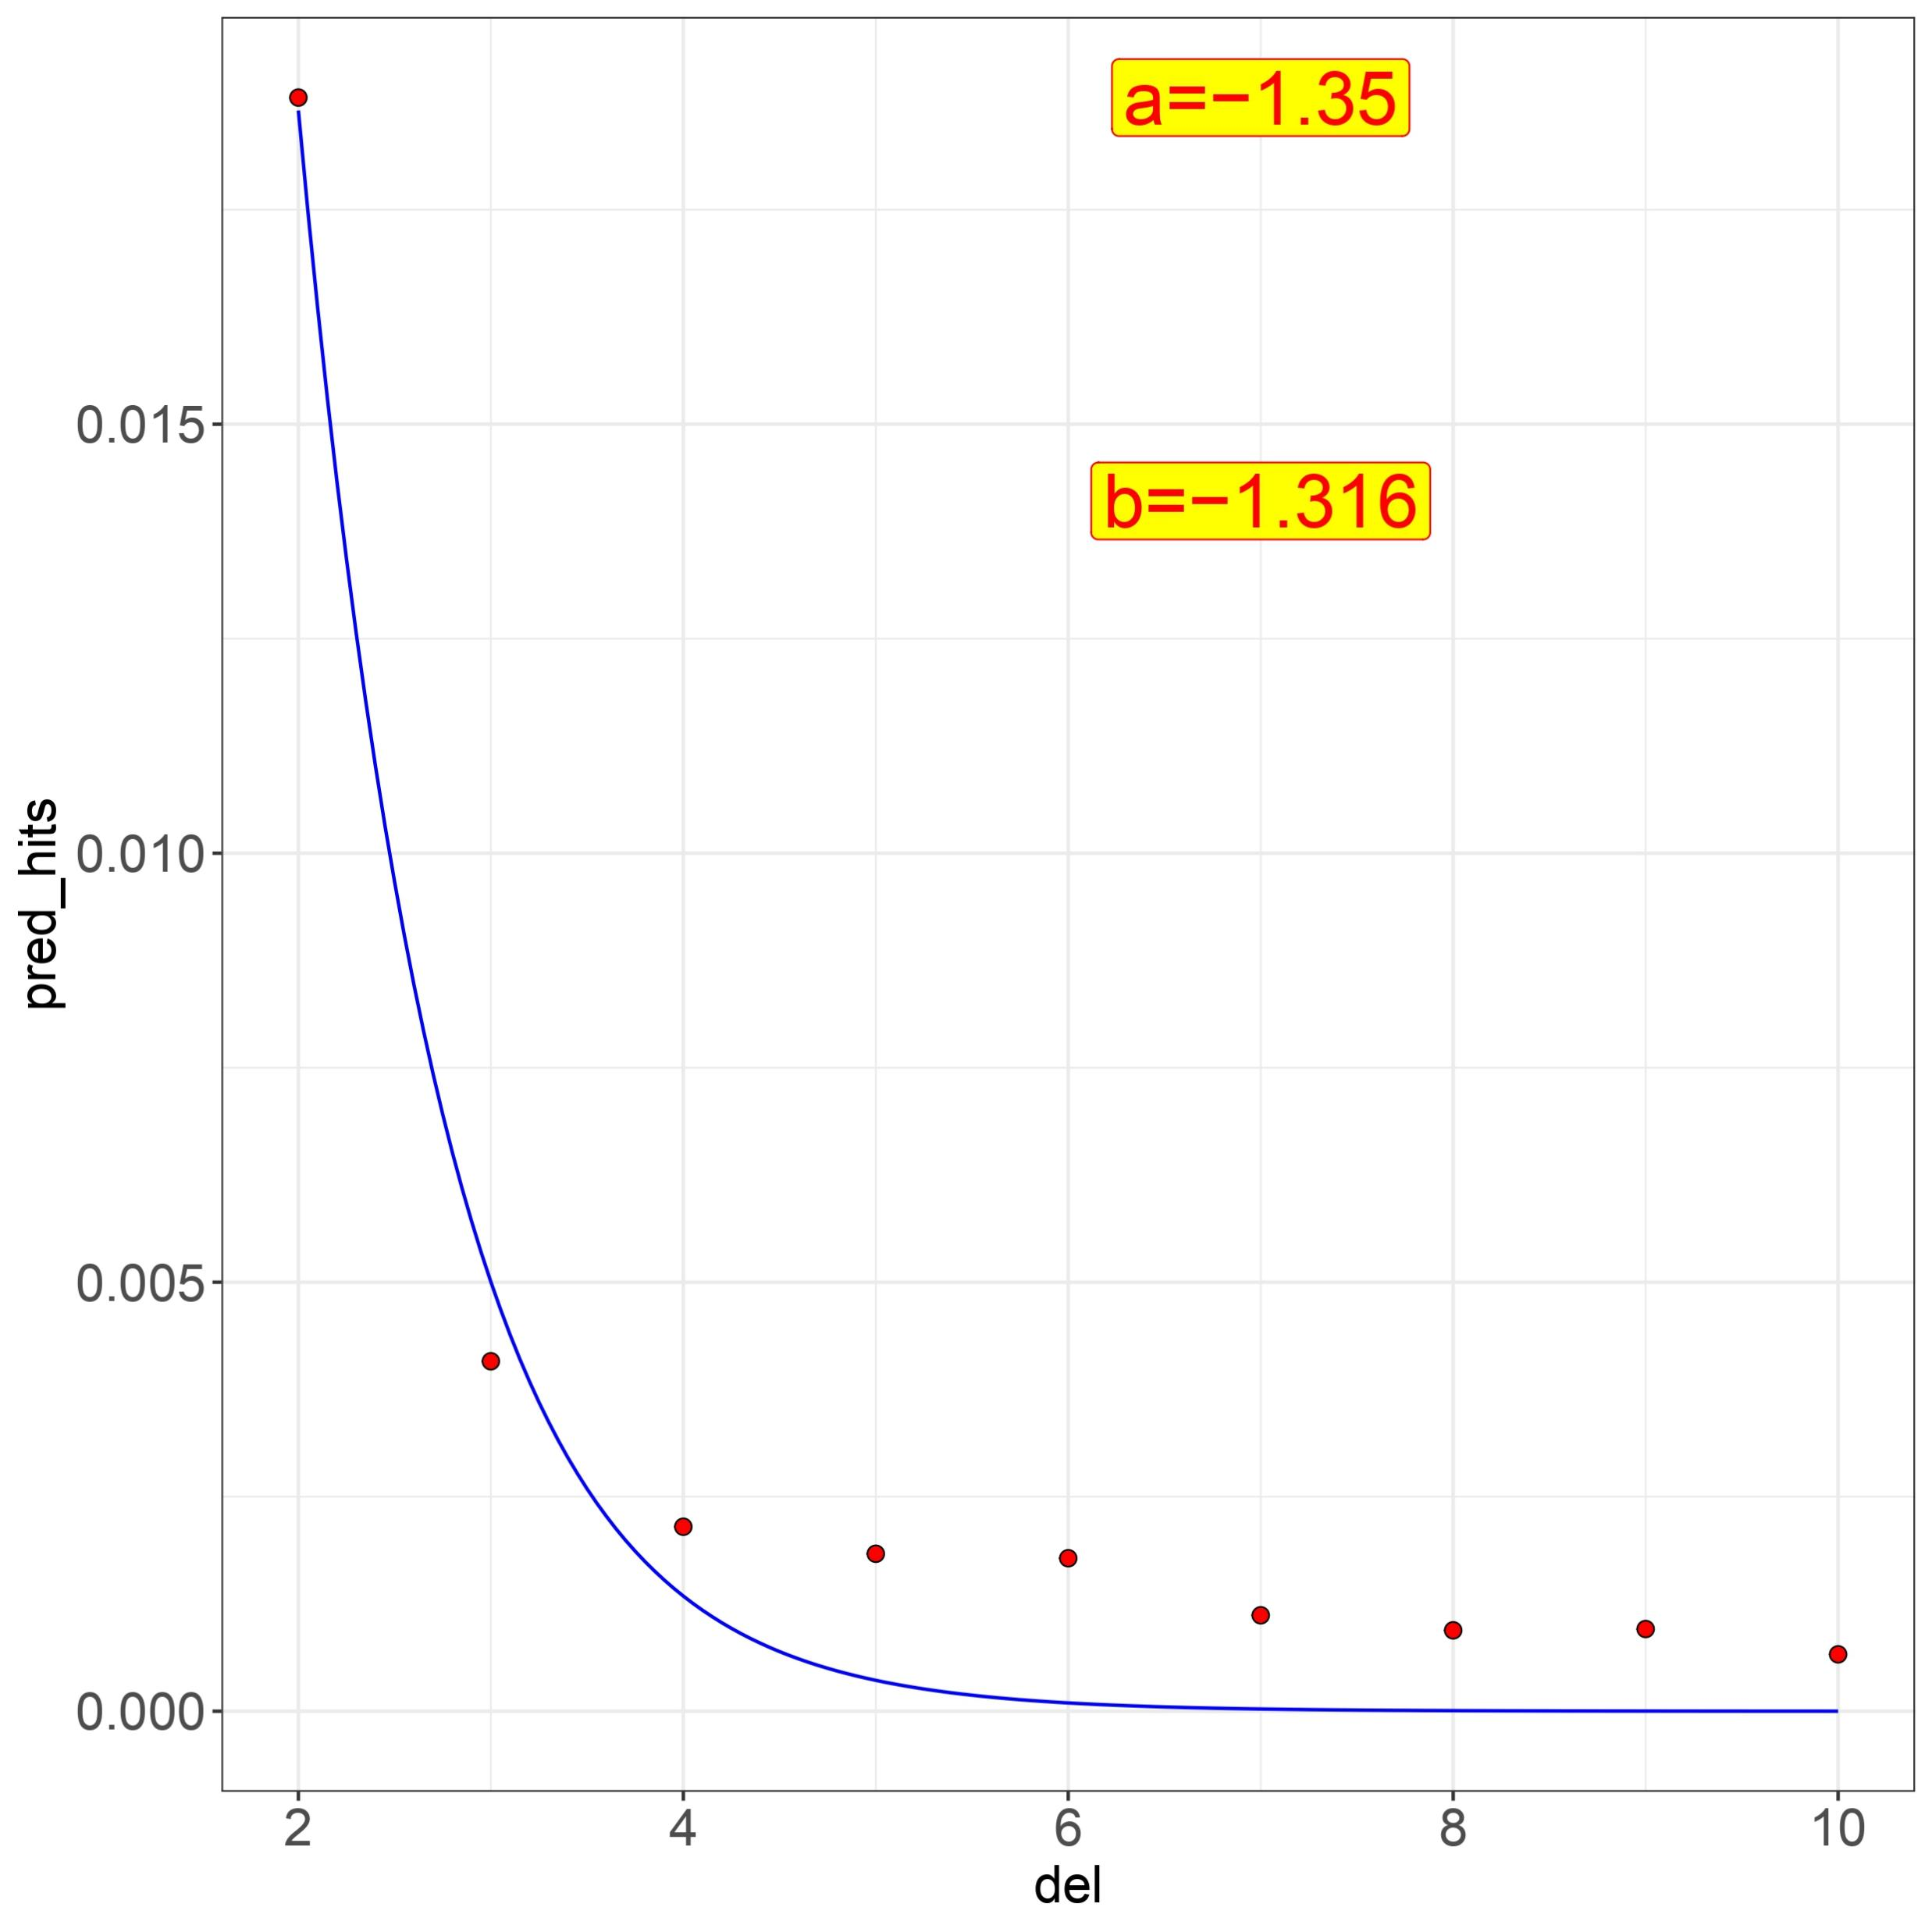
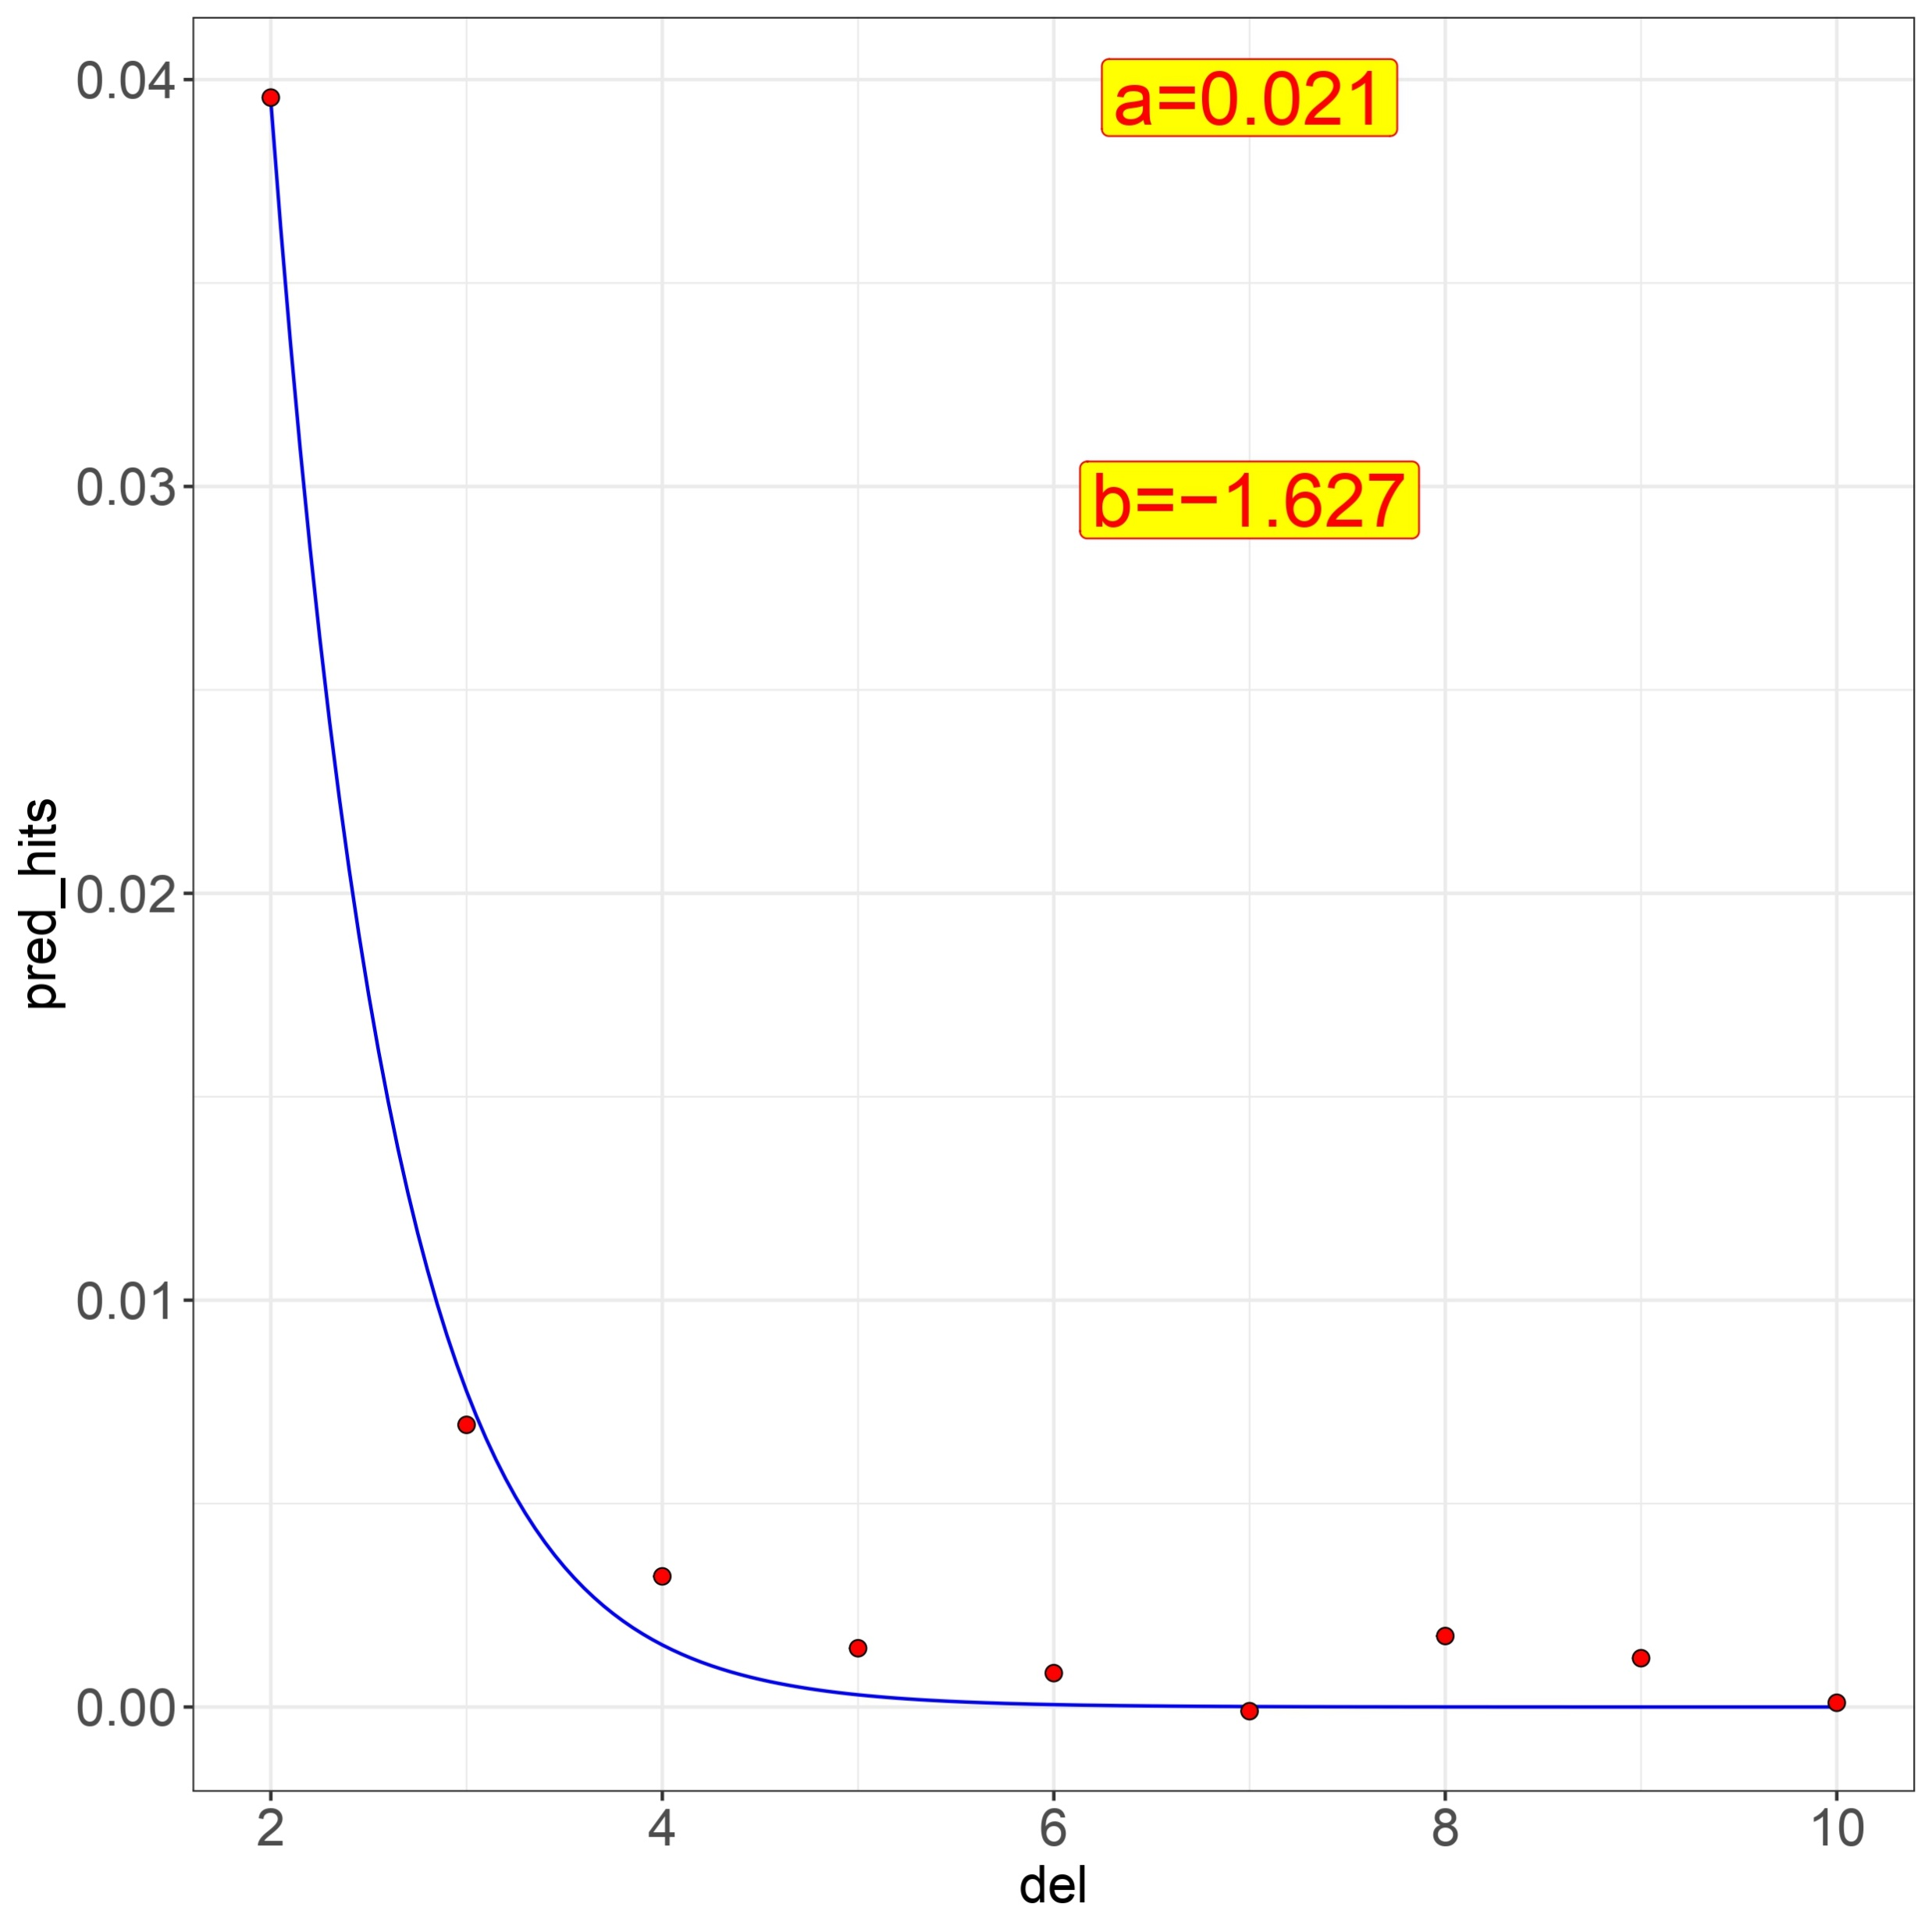
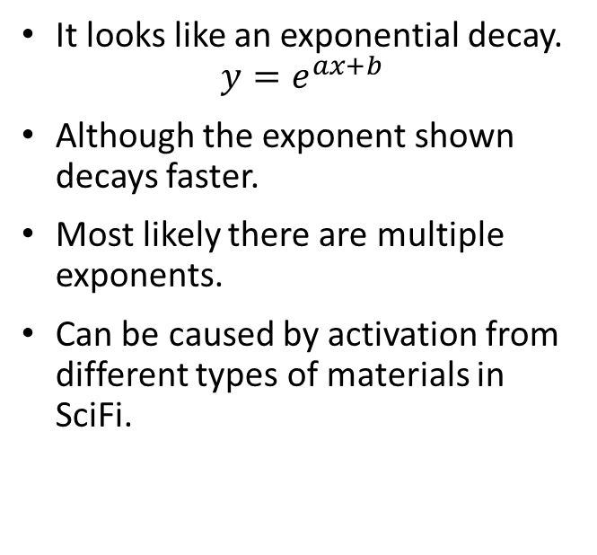
Avg. ee vs. position w.r.t. bb
It looks like an exponential decay.
$$y=e^{ax+b}$$
Although the exponent shown decays faster.
Most likely there are multiple exponents.
Can be caused by activation from different types of materials in SciFi.

Slide 11
Takeaways
ee backgrounds (noise) fluctuate at the order of seconds.
SciFi has activation: ee signal increases w/ mu, exponentially decays over time (away from bbs) and is up to ~25% for outers and ~15% for inners compared
to the signal. Analysis of 1 kHz line w/ finer sampling
can indicate better counter(s).
The standard analysis w/ LogZero (and PGF) will be
complicated due to changing filling schemes, given
we can use tracks and vertices.
We can use the average method for SciFi if we can
estimate the background properly from other
counters. Also, can be used filling schemes for
well-isolated bunches.

Slide 12
Back up slides

Slide 13
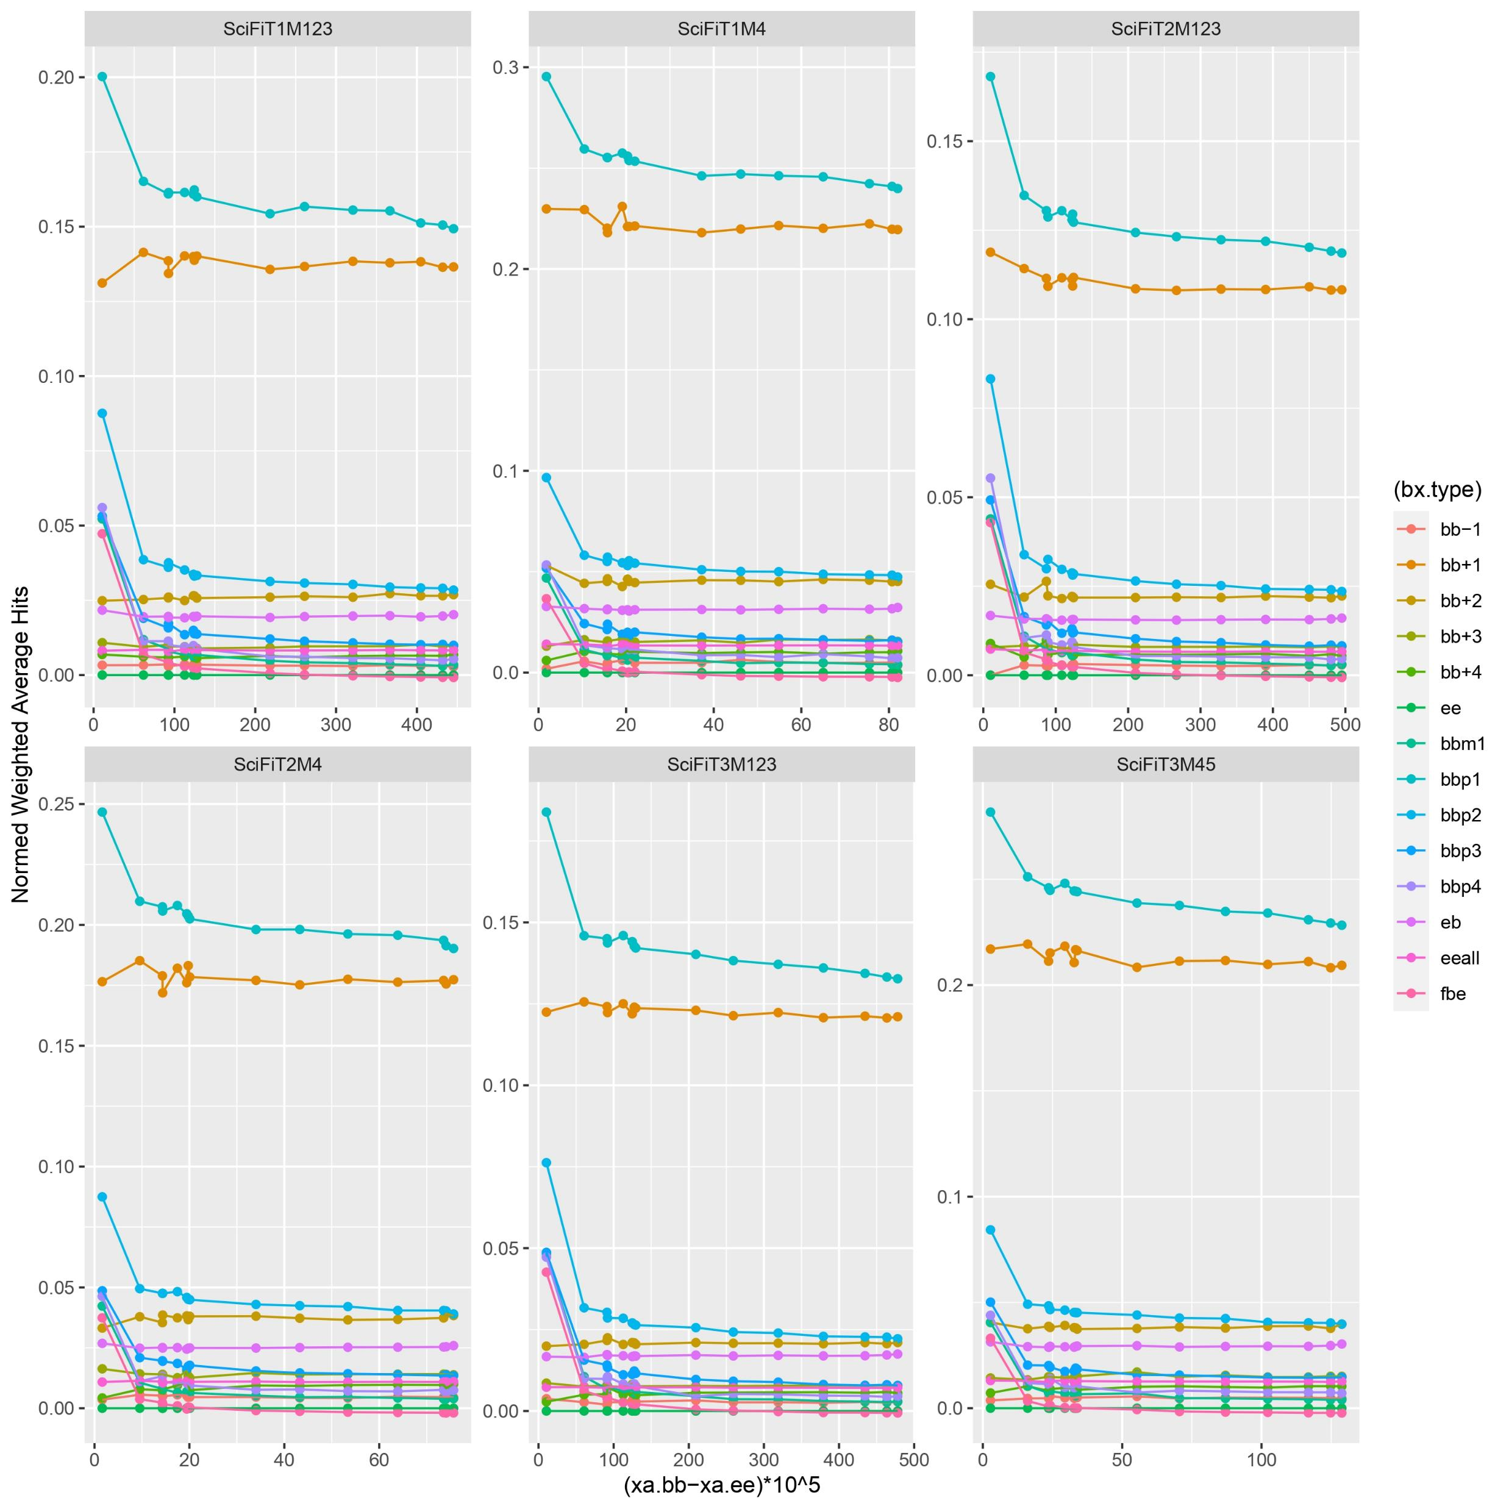
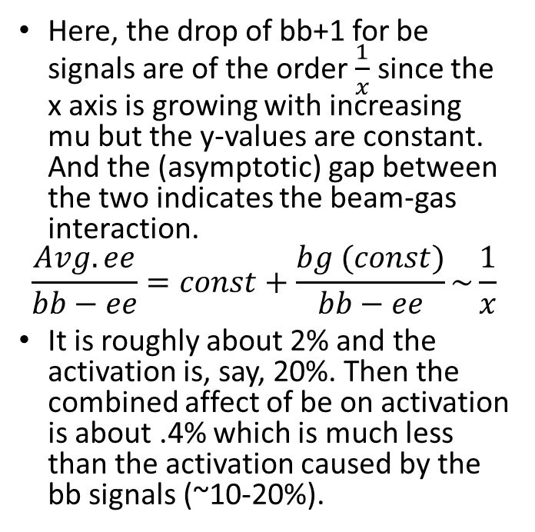
Beam-gas effect
Here, the drop of bb+1 for be signals are of the order $\frac{1}{x}$ since the x axis is growing with increasing mu but the y-values are constant. And the (asymptotic) gap between the two indicates the beam-gas interaction.
$$\frac{Avg. ee}{bb−ee}=const+\frac{bg (const)}{bb−ee}\sim \frac{1}{x}$$
It is roughly about 2% and the activation is, say, 20%. Then the combined affect of be on activation is about .4% which is much less than the activation caused by the bb signals (~10-20%).

